Slide 1
Invest In Me
Practice Guidelines
Produced by: Anglicare WA Home Stretch WA Team

Slide 2
Acknowledgements
We acknowledge all of the elders, foster and family carers, residential care programs, biological families and young people who have so generously and courageously contributed their learned and lived expertise in the design and development of the Home Stretch WA’s Invest In Me Funding approach.
We acknowledge Aboriginal people as the Traditional Custodians of this land. We pay our respects to their strength, cultural resilience and the Elders past and present.
How to use this Guide & Contents
The Practice Guideline has been developed for everyone working and training to implement Invest in Me Funding in Western Australia as part of the Home Stretch WA program. It provides a simple framework for supporting a young person with Invest in Me Funding from 18-21
Home Stretch WA Background | 1
What is Invest in Me? | 2
Invest in Me Funding Guiding Principles | 3
Young Peoples Voices | 4
What have we Learned? | 5
What Can Invest in Me Pay For? | 6
How is over 100 and under 100 process different? | 7
Preparation and Things to Consider - Reflective Questions | 8
Step by Step Guide | 12
Key Documents | 15
Invest in Me - Data Definitions | 16
Roles & Responsibilities | 20
Case Studies | 21
IIM-PG-009-Home Stretch WA –Invest In Me – Practice Guidelines V1.0 Review Date 01/08/27

Slide 3
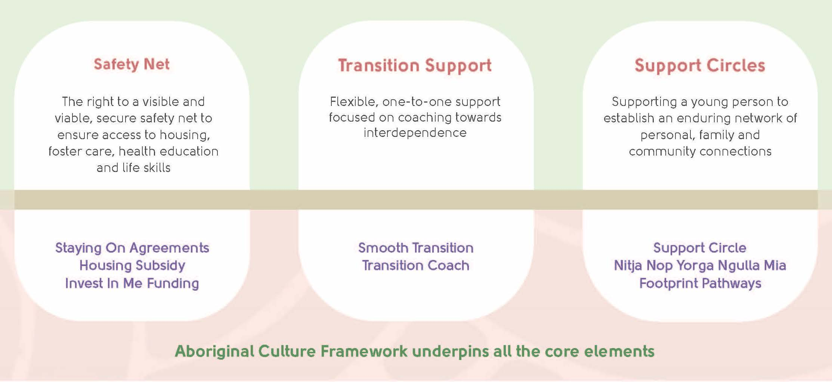
Home Stretch WA Background
Home Stretch WA provides an enhanced support system for young people transitioning from out-of-home care, providing them with additional support and resources from the ages of 18 to 21 years.
The aim is to improve care leavers’ access to housing, health, education, training and employment through the provision of practical one-on-one assistance from 18 years to when they turn 21 years of age.
Invest In Me Funding
The Invest in Me Fund gives young people the ‘right’ to a visible and secure financial safety net that ensures access to resources to support them towards their aspirations and goals, as well as relief in times of crisis.
Invest in Me funding is provided through the coaching relationship and administered by Home Stretch WA service providers.
This funding provides support with timely access to goods and services, whilst encouraging them to become self-reliant.
1

Slide 4
What is Invest In Me?
Home Stretch is focussed on preparing young people to transition into interdependence. Supporting young people to develop their capacity to pay for things like rent, car insurance, education costs, etc, is done incrementally to ensure these things don’t come as a shock to the young person when they transition to adulthood.
We also want to ensure that they have equal opportunities to invest in themselves and their future goals. Invest In Me provides young people with the skills and knowledge to manage their finances, or how or where to access financial support within the community.
The ‘Invest In Me’ process is intended as both a learning opportunity for the young person, but also aids the Transition Coach to have an objective and consistent approach to funding. Invest In Me is more structured rather than discretionary approach to funding and is further intended to support equity for all young people accessing funding through Home Stretch.
What is the intended outcome of Invest in Me?
Each young person will be in a different situation and will possess different levels of capacity when it comes to their funding needs, or at differing stages of ability to contribute in non-financial ways.
While it may feel simpler to fund items, particularly low-cost items, it is intended that each funding request be used as an opportunity for learning and capacity building.
It is intended that young people develop a level of financial literacy, which includes research/ information gathering, budgeting, consideration of priority, available resources, access to available services that may negate the need to use their Home Stretch funding in the future as they become more reliant on funding and resources within the community.
2

Slide 5
Invest In Me Funding Guiding Principles
Right to Support- Not 'deserving' and 'undeserving'.
Responsive- timely and responsive to short-term hiccups that can have long-term consequences.
.
Builds Capacity- develops knowledge, skills and confidence to access mainstream resources beyond those available through the child protection system.
Does not duplicate existing resources – funding needs that can be met elsewhere should be met elsewhere (mainstream resources, public services, rapid response).
Visible & Secure but not without hoops (Responsibility) – mirroring the small hoops young people might have if asking help from primary caregivers.
Individualised– promotes individual choice for individual circumstances.
Young people need to hold decision-making power – the approach must value and celebrate an emerging interdependence.
Transition Coach Practice Principles ​
Chipping In” is about young people taking charge- This means that young people are asked to invest in themselves- building their skills, knowledge and capacity.
You are the expert in your own life, you deserve the freedom and respect to make your own choices- our support is unconditional. ​
A reliable source of support is your right – It's your choice to come and go.
You can make an informed choice about the support you receive from Home Stretch – there are no 'shocks' for you or the important people in your life
​
3

Slide 6
Young Peoples Voices
What young people have told us is important to them
Be responsive & accessible, and treat us as individuals
Help us learn how to become financially independent
Support us unconditionally; failure & bad choices are learning opportunities
Be persistent & consistent, 'like a text message' not a 'knock on the door'
Focus on maintaining & building
our sense of belonging & connection to others
Value & encourage our independence by supporting our decisions & choices
4

Slide 7
What have we learned about Invest In Me?
‘Chipping In’- And contributing to costs- An important but challenging principle to Implement
To access funding and support through Invest in Me, young people are encouraged to make a personal contribution towards the payment of expenses they are seeking funding for.
These contributions are individually negotiated and are not always financial, with young people having the capacity to contribute through other means or actions consistent with their goals.
Young people from the 'Youth Advisory Group' reported that this approach is different to many of their previous experiences, stating that they are usually supported with the full payment of costs towards expenses or the rejection of their funding.
This all-or-nothing approach is not consistent with the experiences of young people outside the care system, highlighting inequity based on circumstance and ultimately disadvantaging care leavers due to a lack of skill development and financial literacy.
Scaffolding Towards Financial Independence & Self Reliance
While there is a need for better access to financial support for young people as they transition to independence, the approach to providing support must also focus on building their capacity, skills and knowledge when they seek financial assistance.
This requires the dedicated time of a skilled worker with a clear, consistent framework for funding and an administrative process that allows for a rapid response to funding requests.
Financial Support needs to include pathways to support young people to understand, consolidate and manage debt
Many young people supported through the Home Stretch Trial shouldered a burden of financial debt incurred through impulsive decision-making when they were younger.
Debt was a significant source of ongoing stress and a barrier to moving forward with their lives. This was particularly evident for the age19+ cohort of young people supported by Home Stretch, many recounting limited access to support to deal with financial problems once they left care.
5

Slide 8
What Can Invest in Me Pay For?
EMERGENCY/ SHORT TERM
These costs are typically unplanned or unexpected and may require immediate attention.
Invest in Me funding helps the young person prevent short-term problems from having long-term consequences.
This may include paying for urgent fines or bills, accessing safe accommodation in crisis, transport to get them to important appointments, and providing support towards paying for groceries or phone credit when they don’t have any income, or their payments have been cut off.
Required assistance may be time sensitive and require a quick response, however, the Transition Coach will provide intentional follow-up support for the young person to reflect and learn how to plan for and overcome these kinds of emergency costs in the future.
Example Costs
Overdue fines or bills
Essential needs- food, clothing, phone/phone credit, transport, smart riders, vehicle repairs, childcare
Emergency Housing- accommodation, rent payment, household furniture
Urgent health costs- medication, health appointments
Emergency transport costs- smart riders, bus tickets, taxi etc.
Unexpected Course Fees
Unexpected Funeral or Significant event costs
ASPIRATIONAL/ LONG TERM
Transition Coaches work with young people to identify and plan for their long-term aspirational goals.
Funding requests are individualised making it important to engage in objective and consistent decision-making processes
Example costs:
Accommodation (house set up costs, removalists, furniture, landlord insurance)
Education & Training (course fees, licences & tickets, educational costs- laptop, textbooks)
Employment (interview clothes, uniforms, professional development skills)
Health & Wellbeing (counselling, gym membership, personal care/hygiene)
Life Skills (driving lessons, first aid course, cooking course)
Legal (legal advice, clothes for court, identification)
Relationships & Support Networks (sports and recreational club fees, social groups, interstate travel, family counselling, art groups)
Identity & Culture (travel costs to visit family or connect to country, language courses, cultural or significant events)
Milestones & Rituals (birthday celebrations, significant event costs- graduation, school balls etc.)
6

Slide 9
How is ‘Under $100’ and ‘Over $100’ funding processes different?
The Decision-Making process for Over 100 and Under 100 is primarily the same, Transition Coaches will discuss and negotiate costs with the young person, using the Decision Matrix, practice principles and Invest in Me practice guidelines.
'Over 100' requests generally require an application to be submitted to the Home Stretch Coordinator for approval, which mimics mainstream funding options and contributes to capacity building.
UNDER $100
Payments under $100 can be made by the Transition Coach without approval.
Transition Coaches may seek feedback and advice from other Coaches or the Coordinator regarding the request.
OVER $100
Will require approval from the Home Stretch Coordinator after making an ‘Invest in Me’ funding application.
Coaches can assist young people with the application, or the young person can submit the application themselves.
Transition Coaches can seek feedback and advice from other Coaches or the Coordinator prior to the request.
7

Slide 10
Preparation
s
When a young person reaches 18, they will be eligible to receive a Centrelink payment, as well as a range of other financial support that is provided to the community.
As part of developing a young person's capacity there are a few key things we may ask the young person to consider before approving any funding requests, as this helps them to develop the important skills of need/ want consideration, creative problem-solving and self reflection.
There are times when a rapid response to funding is necessary, and reflective practice and future planning can be facilitated by the Transition Coach post payment.
Things to Consider- Reflective Questions
PROBLEM SOLVING- Can they fix this themselves?
Has the young person thought about another way to solve the current problem/s? As their Transition Coach, you can help them think of solutions and brainstorm potential ways to overcome these kinds of problems in the future.
Examples:
If the young person is stuck with no money for the bus, you might ask them if they can borrow money from someone or set up an auto-load smart rider so they don’t have to think about this every week.
If the young person has broken their phone, ask If they can borrow someone else’s until they can get theirs fixed.
If they keep getting stressed with overdue bills or loans, they can think about whether they really need the loan before they apply for it.
Supporting young people to problem solve regularly helps them to not only build skills and capacity, but also supports them to develop self-efficacy and confidence in their capabilities and ability to be resourceful.
8

Slide 11
Things to Consider- Reflective Questions
SKILL DEVELOPMENT- What skills can they learn?
Investing in young people’s futures also includes the teaching of new skills regarding financial literacy, what community support is available and how to access it now and if they need it in the future.
If they can’t chip in financially, you can recommend something else they can do to contribute, which could be a good opportunity for them to learn new skills.
Examples:
If they need to get their car fixed, they can negotiate with you that Home Stretch pays for the repairs, but they are encouraged to call around and get quotes so that they can learn how to access mechanics, and the best deal, in the future.
If they need Health Insurance, you may ask them to get some quotes so they can find the best possible deal and how to cut costs.
CHIPPING IN- How much can they afford to pay?
If the young person is getting their own income, you might ask them to contribute to the costs. This is a meaningful way for them to develop knowledge and skills around thoughtful spending and is also a good way for them to practice investing in themselves and their goals.
This might mean sitting down with your young person to develop a budget or saving plan or negotiating an amount that they think is reasonable to contribute.
Examples:
If the short course they want to do is $100 they might work out that they can put $20 towards the course this pay.
If they want to buy a new car Home Stretch might agree to pay half if they save for the other half.
They agree to a payment plan of $20 per fortnight for their TAFE fees and Home Stretch will pay for their laptop.
When the young person is chipping in you might find that they feel more motivated to achieve their goals because they have invested in themselves and their own money. They may feel more confident paying for things in the future.
9

Slide 12
Things to Consider- Reflective Questions
FUTURE PLANNING- What is important for the future ?
It is important to encourage young people to reflect on their longer-term goals, what’s important to them, and how their current funding request supports them achieving their goals.
It is likely that a young person will need financial support for something that is completely unrelated to their future goals, but it is always beneficial to reflect on how current spending may impact future fund availability – A young person could be encouraged to consider:
Am I using my access to funding in the most beneficial way? Are there other options available to achieve my current goals? Have I researched all the possibilities?
Example:
If they’re applying for a course in ‘business’, you can sit down with them and ask if they have really thought about why they want to do ‘business’ and what research they have done into this industry. Providing the opportunity for the young person to talk it through with you by asking curious, open-ended questions, you may find that they weren’t completely across all the details and that a graphic design course is much more their vibe. By planning with the young person, they may realize there is a world of opportunities they never even thought possible. .
OTHER OPTIONS- What else is available?
There are many other services that already cover costs or offer cheaper alternatives that you can support your young person to explore.
Example:
You can discuss getting a discount on TAFE fees, or gain access to a Bond loan for housing, that they can opt to use their TILA to pay for furniture costs, or how to access a public dental service instead of a private one.
By knowing what resources are available it can help the young person to manage their own costs in the future.
10

Slide 13
Things to Consider- Reflective Questions
DEALING WITH CHALLENGES
There may be times where the young person will find this overwhelming and hard, and that’s okay. That’s why you are there to support them.
You will walk alongside them, listen to what is important to them and what is a challenge, and support them to find the resources they need.
As their coach, you will also challenge them to take ownership of their own financial wellbeing – helping them to become responsible, resourceful, interdependent, and capable of advocating for their rights and what they want for their future.
10

Slide 14
How Are Decisions Made?
Every decision regarding ‘Invest In Me’ funding is made based on a young person’s individual circumstances.
Home Stretch Transition Coaches are guided by the principles of Home Stretch and use the ‘Invest In Me- Decision Matrix- Practice Guide’ to ensure consistent and equitable support for all young people accessing Home Stretch.
When making the decision to provide funding, be mindful of the amount of funding the young person has access to, if the funding is being used to support the young person to transition into adulthood, and if it is helping them to achieve their goals.
For example, a young person may be frequently asking for food vouchers to do grocery shopping. In emergency situations this type of support is okay as a once off, however, this is not something that can be sustained and isn’t good use of the young person's funding. Instead, as their Transition Coach you could help your young person by supporting them to access a financial counselling service to teach them budgeting skills, or their local Emergency Relief services to help them with groceries till they’re paid again. By doing this, you’re not telling the young person that you won’t help them, instead you’re teaching them valuable skills they can utilize once they age out of Home Stretch.
Situations like this may also present an opportunity to remind the young person of their aspirational longer-term goals and the benefit of utilizing their ‘Invest in Me’ funding to achieve what is important to them.
Young people have the option to appeal decisions made if they disagree with the outcome.
11

Slide 15
Step by Step Guide
Provide the Young Person with Information on Invest In Me Funding , what it can be used for and the process of accessing funding.
When a Young Person requests an Item, discuss the request using the Decision Matrix as a Guide
If Request is under 100 pay for the Item
If Request is over 100 support the young person to complete an Invest In Me Application and submit for Approval from the Home Stretch Coordinator
Arrange for payment of the item and record on data management system
If Item not approved let young person know of appeals process
INVEST IN ME PROCESS
AWARENESS
Provide information about Invest in Me
FUNDING REQUEST Discuss Request with Transition Coach
APPLICATION- UNDER 100 Pay for the item
APPLICATION- Over 100 Complete Invest in Me Application
PAYMENT Arrange for payment
APPEAL
12

Slide 16
APPLICATION For Invest in Me
Applications for Invest in Me Under 100 and Over 100
DISCUSS INVEST IN ME APPLICATION UNDER 100 & OVER 100
APPLICATION FOR OVER 100
Coach discusses requests with young person. Coach support applications over 100 and approve under 100 directly using decision matrix as a guide
Request submitted to Home Stretch Coordinator for Approval of over 100 using Invest in Me Application Form
Check Out: Home Stretch WA- Invest In Me Decision Matrix- Practice Guide
Home Stretch WA- Invest in Me Application Form
PAYMENT of Invest in Me
Paying for Requests
INVEST IN ME PAYMENT
If approved- requested item is paid for by the transition Coach via payment methods.
APPEAL- Appealing decisions
APPEALS
If request is not approved or young person disagrees with the decision they can appeal the decision
Young people can contact the Home Stretch Coordinator or go through the appeals process
13

Slide 17
EXIT Young person turns 21 or decides to move on
We start planning early so you have time
HANDOVER SUMMARY
HANDOVER SUMMARY
Staying On finishes when you turn 21 or move on
When they turn 20, the young person and Transition Coach meet to work out what happens after 21 and plan for costs that might need to be covered by CPFS from 21-25
Handover summary is submitted to Department with summary of spending if young person ages out or opts out
14

Slide 18
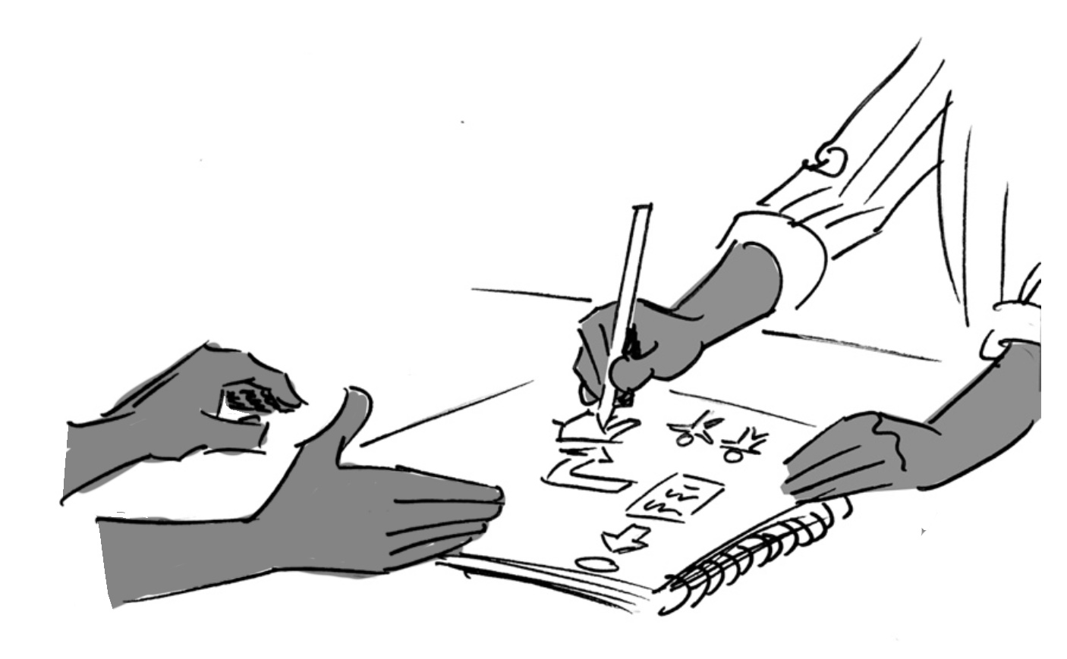
Key Documents
Core Documents – Invest In Me Funding
Invest in Me - Flow Chart
Invest in Me - Decision Matrix- Practice Guide
Invest In Me - Application Form- Over 100
Invest in Me - Fact Sheet- Young People
Invest in Me - Leaving Care Fund Access Form
Working Together Guide - Financial Support from the Leaving Care Fund
Invest in Me - Data Definitions
Bulk Invest in Me Application & Practice Guidelines
Supporting Documents – Practice Tools & Guides
Budget Template
Transition Coaching Practice Guides
15

Slide 19
Home Stretch WA-Invest in Me Funding
Data Definitions
Transition Coaches are responsible for recording the use of Invest In Me brokerage funding into each Home Stretch Providers data tracking system.
All brokerage spending must be recorded and include the following data;
The amount spent
The respective life domain for that expensive
Whether the spending was Aspirational or Emergency
Data Definitions
When recording data against spending, the Transition Coach firsts makes an assessment about whether the identified costs are arising from an Aspirational need or an Emergency Response.
Aspirational
Emergency
Young person has identified and planned for future expenses that are consistent with their longer-term goals.
Funding is primarily used to build the individual capacity and opportunities available to young people.
Funding may be ongoing and support a young person towards long term aspirations.
Unplanned short-term costs that arise and require financial support to resolve
Focus on reducing harm and preventing short term problems from becoming major barriers for the future.
The young person is supported to exhaust other mainstream options
Typically one off payments.
Safety Net Spending Categories
Transition Coaches must allocate costs to one of the domains outlined in Transitioning from out-of-home care to Independence: A Nationally Consistent Approach to Planning.
The following list provides guidance around how expenses should be recorded to insure consistency in data collection;
16

Slide 20
Home Stretch WA- Invest in Me Funding
Data Definitions
Financial security:
• Any financial assistance provided to young people to assist them to manage or repay debt [limited circumstances]
• Any financial assistance provided to assist with the payment of utilities, that are not directly related to maintaining housing. Only when other government grants and emergency relief options have been exhausted.
• Emergency material aid for essential needs (Food, clothing, phone/ phone credit, transport assistance ie Smart riders, vehicle repairs, childcare).
• Access to specialist financial counselling or support, including financial advice and resources to improve a young persons financial literacy.
Identity and culture:
• Costs associated with activities that promote a young person’s connection to country, culture, and their community.
• Costs associated with activities that support a young person to develop an understanding of their beliefs and values.
• Personal development related to improving knowledge and awareness of culture or personal identity. Cultural mentoring or cultural learning camps
• Travel costs associated with attending significant places or events that have a cultural meaning to the young person.
• Specialist family finding services for young people that require expertise in that young persons culture. [Who’s My Mob etc]
Life and after-care skills:
• Activities and events that provide opportunities to develop life skills, specifically those that support a young person to live independently and improve their awareness of their rights.
• Costs associated with activities that support a young person to build confidence in interpersonal relationships and improve their social skills.
• Low cost activities that assist with developing rapport and engagement with support services and Home Stretch transition coach [small meals or coffees that are part of an engagement plan developed by the transition coach]
• Costs related to celebrations of important life milestones
• Driving Lessons
17

Slide 21
Home Stretch WA- Invest in Me Funding
Data Definitions
Housing:
• Expenses related to the establishment and maintenance of safe and stable housing options
• Payments made to prevent eviction (Rent, rent arrears, repairs) Does NOT include assistance to repay debts or other financial barriers to establishing housing.
• Essential home equipment (inc furniture/white goods) [Where the TILA Grant is not able to be used or has been exhausted]
• Does not include costs related to the payment of Housing Allowance or Staying On Subsidy.
Health:
• Costs and expenses related to the provision of health, dental mental health and allied health services. Private services are only accessed where there is a clear rational for their use and the young person would be placed at significant disadvantage or risk by unreasonable waiting periods.
• Payment of health insurance, ambulance insurance and other related costs that assist a young person to have better access to health care.
• Includes expenses related to personal care/hygiene products, and relevant services.
Education & Training:
• Costs related to education, training or employment related skill development. Where possible the Rapid Response Framework should be activated and subsidised training costs explored.
• Costs related to education, training or employment related skill development. Where possible the Rapid Response Framework should be activated and subsidised training costs explored.
• Educational equipment or materials/resources that are relevant to and individuals career pathway. (inc laptops, textbooks, uniforms, tools ie chef knives/ makeup brushes)
• Education related travel expenses.
18

Slide 22
Home Stretch WA- Invest in Me Funding
Data Definitions
Employment:
• Costs that relate to finding or maintaining employment that cannot be met by the federal job active system or other specialist employment services funded to work with young people
• Professional registration, accreditation or licensing costs [WWC, professional association
• Employment specific equipment/uniforms (inc uniforms, tools, clothing for interviews)
• Financial assistance provided to young people to assist in the establishment of their own small enterprise and small business [business insurance, registration costs] Only when all other resources have been exhausted.
• Professional career guidance and other professional development opportunities (inc conferences, training, camps)
Social relationships and support networks:
• Costs associated with supporting a young person to connect or reconnect with biological family members, including the cost of travel or to attend specific activities that support these opportunities
• Costs related to travel that is specifically for the purpose of family reunification or connection
• For young people in Staying On Agreements, any additional expenses related to supporting or resourcing the living arrangement. Can include costs associated with supporting carers with specialist education, training or support that is directly relevant to supporting the young person. *These expenses require management approval and are limited in scope and scale.
• Costs related to the young person engaging with recreational activities including sports, short courses, events and other opportunities that are directly related to developing their support circles, friendships and natural networks.
Legal matters:
• Any costs related to a young person seek legal advice or legal support. Assistance to navigate Criminal Injury Compensation claims should be sought through existing services provided to young people in care.
• Payment for access or processing of any legal documents that are not related to employment or education. Including fees related to applications to the court and family court. [Birth certificates, access to medical records etc]
19

Slide 23
Roles & Responsibilities
What are the responsibilities of a young person?
Talk to the Transition Coach about the support that you need
Complete Invest in Me Applications over 100
Give feedback on process and appeal decisions if required
What are the responsibilties of the Home Stretch WA Transition Coach?
Pay for items under 100
Support young people to complete applications for items over 100 and make payments when approved
Administration and record keeping of expenditure
What are the responsibilties of the Home Stretch WA Coordinator
Approve Invest in Me Applications Over 100
Support the Transition Coach with decisions about Invest in Me
Available for appeals of decisions
Administration, tracking and reporting on Invest in Me Spending expenditure per young person
What are the responsibilities of Home Stretch WA provider?
Provide information about Invest In Me to Young People
Transparent process for young people on how decision are made
Complete handover summary of expenditure when young person opts out or ages out of the program
What are the responsibilities of the Department of Communities ?
As part of Working Together with home Stretch Providers, negotiate costs that will be paid for Leaving Care Fund prior to 18 and after 18
Direct young people back to the Home Stretch Provider if they come to a District for Invest In Me Requests
20

Slide 24
Example Case Studies
Jay- Emergency- Invest In Me Funding
Jay has an argument with his boyfriend smashes his phone in a furious rage, but does not have any money to replace it.
Jay goes into a district office to ask for help. The duty officer sees he is part of Home Stretch and gets referred back to his Transition Coach.
Jay uses his partner’s phone to connect with his Coach through Messenger.
Jay and his Coach arrange to meet at a local café the following day, and they have a chat about what happened.
Jay explains that he is having issues with his temper as he is feeling overwhelmed with his living situation and reporting requirements for Centrelink and Corrections.
Jay and his Coach recognise that it is important to stay connected so he is able to report and be contacted by the different services and supports.
Jay and his Coach go through what options are available to fix or replace the phone. The phone is smashed beyond repair and he hasn’t enough money to buy a new one.
Jay has had a phone supplied through Invest in Me Funding before. For this reason the coach offers to help with the cost of the phone up to $150.
Jay needs the phone urgently he is happy to get a basic model, so the Coach makes an application to the Co-ordinator on his behalf.
The coach calls the Co-ordinator to express the urgency of the request and speed up the application.
The Coordinator approves the request.
There isn’t a phone store near by so the Coach orders the phone through click and collect.
Jay catches the bus to the store near his home and picks up the phone. Jay buys a cheap phone case at the store to protect his new phone.
21

Slide 25
Example Case Studies
Jay- Aspirational- Invest in Me Funding
Jay is 19 and has been thinking a lot about how he is going to get to TAFE next semester.
He lives an hour away from the TAFE campus on public transport, which made him late a lot last semester.
Jay is now studying his Diploma in Community Service and is using VET Fee Help to cover the costs.
Jay is working part time at a fast food restaurant, but only earns about $120 per week, and receives his Youth Allowance payment of $230 per week. He hasn’t been able to save any money.
Jay really wants to get a car.
Jay talks to his coach about his plan to try and buy a car through an ad on gumtree and how much Home Stretch can support him with. He hasn’t bought a car before, but has his license.
He speaks to his coach about it, the coach lets him know Invest In Me can help with some costs but first he has to make a plan and figure how he can afford it.
The coach helps him to figure out some details
Create a savings plan to figure out how much he can afford.
Understand the costs that come with owning and running a car.
Other ways he can buy the car through loans.
Jay asks his coach if Home Stretch will pay $2500 for a $3000 car.
His coach tells him that is unrealistic and he needs to pitch in more than $500.
Jay goes home feeling pretty annoyed about the situation and unsupported by his Home Stretch coach.
He looks back over some of the planning stuff he did with his coach and thinks he might be able to pay more but it will take longer to get the car.
Jay meets his coach again and they talk about how Jay could save up more money, and they agree that when he gets to $1500 that Home Stretch might be able to help him with buying the car.
Jay and his coach take all the things they have worked out together, and write them into the Invest In Me application.
In the form Jay has to show how his plan for maintaining a car, and also why he needs the car and how it is connected to his goals.
They attach the savings plan and some other info about the planning they did together.
22

Slide 26
Example Case Studies
Jay- Aspirational - Invest in Me Funding
Continued…
Jay gets a call from his transition coach about a week later saying that the Home Stretch Coordinator has looked through his application and is happy to support it.
They agree to check in every fortnight to see how the savings plan is going, and also to start looking at cars together to keep the motivation up.
Jay toughs it out catching public transport to TAFE for 5 months.
He saves up over $1500 by working some extra shifts. It took longer than he first thought.
After looking at cars for the past few months he has found a car, his Home Stretch coach suggest that they use Invest In Me to fund a car inspection by a mechanic.
He fills in the Invest In Me application for this cost by himself on his mobile phone.
Jay buys his a $3000 car that he can use to get to TAFE and back, as well as get around on weekends.
After driving to TAFE he realises that it is expensive covering the fuel costs, and starts doing car pooling with his friends from TAFE
23

